Slide 1
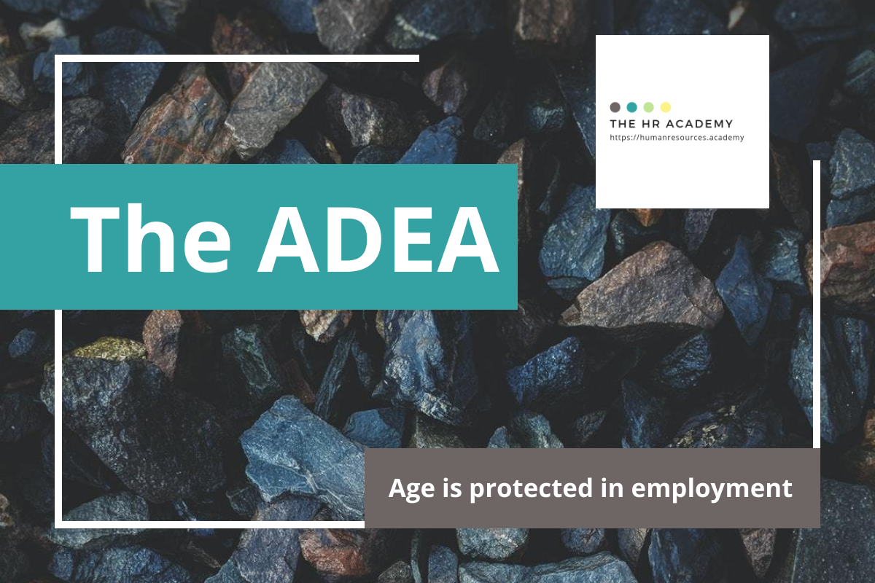

Slide 2
The ADEA: Age and Employment
Q. How would you respond?
The owner of your company orders a manager to fire the 54-year-old office manager because she “looks old, sounds old on the telephone,” and is “like a bag of bones.” The office manager comes to you asking for advice. (This is based on an EEOC case against Hawaii Healthcare Professionals, Inc., that settled for nearly $200,000).

Slide 3
The ADEA: Age and Employment
Q. What would you do?
An older employee comes to you in tears, claiming that he is being bullied and harassed because of his age. He alleges his coworkers in the design firm refer to him as a “design-o-saurus” and tease him about being forgetful and unable to “keep up.” Even though these comments don’t explicitly mention his age, he believes they are code for ageism and age-based harassment.

Slide 4
The Case
In Gross v. FBL Financial Services, Inc., the Supreme Court considered the claim by Petitioner Gross that his employer demoted him due to his age. Importantly, the Supreme Court held that in an age case under the ADEA, age must be the but for cause of the challenged adverse employment action. Unlike the burden-shifting framework found in a Title VII analysis under Price Waterhouse, for example, in an age case under the ADEA, it is solely the employee’s burden to show that, but for their age, the employer would not have taken the adverse action against the employee. Thus, the Court established that age cannot simply be a motivating factor in an adverse employment action; it must be the but for cause of that action in order to be illegal under the ADEA.
Gross v. FBL Financial Services, Inc., 557 U.S. 167 (2009).

Slide 5
The Bottom Line
Age discrimination is illegal under the ADEA for employees over 40 years of age. However, age cannot simply be a motivating factor in an adverse employment action. An employee must show that, but for their age, the employer would not have taken the adverse employment action in question. The employee has the sole burden to prove that age was not simply a motivating factor, but rather the but for cause of the adverse employment action.

Slide 6
Download more free HR Expert Toolkits!
Visit The HR Academy
https://humanresources.academy

