Slide 2
Title VII: Language and Accent Issues
Q. How would you respond?
You have received multiple complaints from customers, clients, or patients about an employee who speaks with a pronounced accent. The employee is a high-performing team member and has been recently promoted to a supervisory role. In addition to customer complaints, employees supervised by this employee have commented that he is difficult to understand and “speaks softly.”

Slide 3
Title VII: Language and Accent Issues
Q. What would you do?
In the situation above, your direct supervisor, the owner and CEO of the company, comes to you and instructs you to fire the employee with a pronounced accent because “he’s just too hard to understand, and he’s driving people away, affecting our bottom line.” The CEO tells you that the employee had better be gone tomorrow, “or else you’re going to have a lot bigger issues to deal with.”

Slide 4
The Case
In Hoang Nguyen v. Unified Gov't of Wyandotte Cty., the U.S. District Court for the District of Kansas ruled against an employer that had demoted a plant engineer of Vietnamese national origin, despite his positive performance evaluations in every area of his work. Nguyen was replaced by a less qualified individual, and his supervisor testified that Nguyen was “’hard to understand sometimes,’ ‘he tend[ed] to speak pretty softly,’ his ‘pronunciation ... is a little bit deficient ... given the time he’s been in [the U.S.]’, and ‘it’s very hard to understand him’ particularly in a big group meeting.” Id. at *4. The court found that Nguyen’s accent was a primary factor in his demotion, and noted that “Accent and national origin are generally inextricably intertwined.” Id. at *9.
Hoang Nguyen v. Unified Gov't of Wyandotte Cty./Kansas City, Kansas, No. 16-2654-JAR, 2018 WL 587231, at *9 (D. Kan. Jan. 29, 2018).

Slide 5
The Bottom Line
Discrimination against someone because of their accent or language issues is illegal under Title VII of the Civil Rights Act of 1964, as amended. Language, accent, and national origin are all connected, and Title VII expressly prohibits discrimination based on national origin. Many courts have ruled similarly to the court in Hoang Nguyen, noting the relationship between national origin, language, and accent issues.

Slide 6
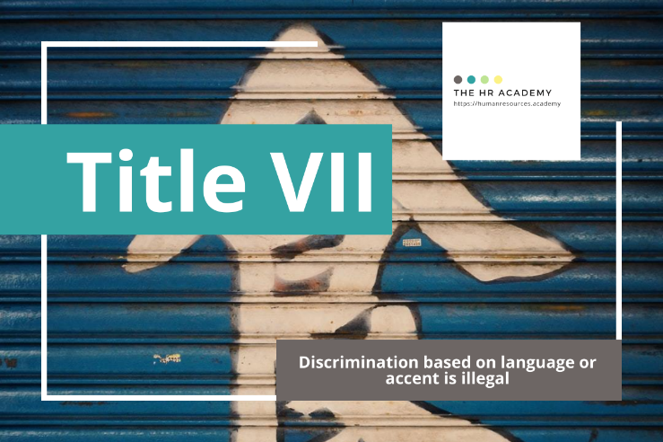
Download more free HR Expert Toolkits!
Visit The HR Academy
https://humanresources.academy

