Slide 2
Overview: Disparate Treatment
Q. How would you respond?
An employee comes to you and complains that she is being treated differently than other employees because she has medical restrictions in place due to a heart attack; the organization is placing her on administrative leave for an inability to perform the essential functions of her job. Other employees have failed fitness-for-duty exams in the past, but she feels the employer is targeting her and treating her differently because of her race and sex.

Slide 3
Title VII: Language and Accent Issues
Q. What would you recommend?
In the situation above, the employee indicates she intends to file a discrimination claim with HR and then the Equal Employment Opportunity Commission because she believes the actions against her constitute illegal discrimination. In your current role, what would you say or do in response?

Slide 4
The Case
In Lewis v. City of Union City, Georgia, the 11th Circuit Court of Appeals held that a “comparator” in anti-discrimination claims must be similarly situated in all material respects. Jacqueline Lewis, an African-American woman, suffered a heart attack the year after her promotion to detective, but was cleared to return to work without restrictions. When the Police Chief announced a new policy requiring officers to carry Tasers and pepper spray, Detective Lewis’s physician recommended that she not be near either, due to her previous heart attack and chronic conditions. The City placed her on leave and then terminated her, claiming she could not perform the essential functions of her position.
Hoang Nguyen v. Unified Gov't of Wyandotte Cty./Kansas City, Kansas, No. 16-2654-JAR, 2018 WL 587231, at *9 (D. Kan. Jan. 29, 2018).

Slide 5
The Case
Lewis sued for race and gender discrimination under Title VII, the Equal Protection Clause, and 42 U.S.C. § 1981. Lewis offered two comparators who had failed a physical fitness test. In one case, the comparator passed the test on the second attempt. In the other, the employee was terminated. The 11th Circuit held that an employee and her comparators “must be sufficiently similar, in an objective sense, that they ‘cannot reasonably be distinguished.’” Id. at 1228 citing Young, 135 S.Ct. at 1355. In this case, Lewis did not meet her burden to show that her comparators were sufficiently similar to her.
Lewis v. City of Union City, Georgia, 918 F.3d 1213 (11th Cir. 2019).

Slide 6
The Bottom Line
Under the McDonnell Douglas burden-shifting framework, an employee has the burden to demonstrate that she was treated differently from other individuals who were similarly situated. The 11th Circuit clarified that this includes all material respects of the treatment in question.

Slide 7
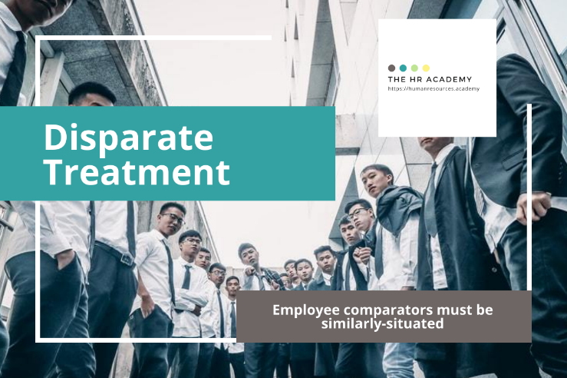
Download more free HR Expert Toolkits!
Visit The HR Academy
https://humanresources.academy

